Slide 1
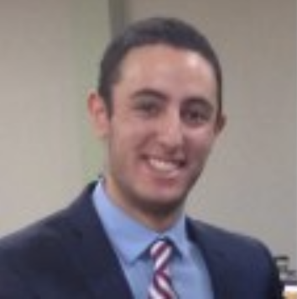
Hi, I’m Mahmoud Nasser and this is me…
Things I’m great at, you can count on me for
Good technical and communication skills
Getting the work done
In the remote world that we live in right now, you can rely on me for being responsive
Things I love (in work and life)
Coding and learning new skills
Watching sports (especially football!)
Playing board and card games with friends and colleagues
Social events where I can get to know colleagues outside of work
Things I need
Junk food
To work on a role I find interesting
Best way to communicate with me
Messaging through Slack
Email
Webex
Phone call
The ways I like to receive feedback
Where I can best improve myself that can make me perform better both within the role but also as a consultant. I appreciate honest feedback and don’t take constructive criticism in a negative way
Time/hours I like to work
Usually between 9-6pm but I am happy to have the occasional meetings/collaboration outside these hours when required.
Things I struggle with
Executing tasks within a project without knowing the purpose behind them.
Things I’d like you to know about my personal / home situation
There is nothing in particular but if I’m ever offline during the working day for any unplanned reason, then please message me on Slack as I’ve always got my phone on me to check and respond to.
What makes me wonderfully weird
I like to joke around a lot and will always diffuse tension if the right opportunity presents itself. I feel I’m very easy to talk to and work with. I also believe that I get along with anyone I work with and will generally find interests in common to talk about that may be outside project work.
Any other things to know about me…
I love to socialize so if you ever feel like chatting nonsense with me, I’m happy to do so! I can speak Arabic, French in addition to English so we have our language of choosing! I’m also a big Manchester United fan so if they win and you feel like you can congratulate me the following day, feel free to do so!

